Slide 1


Slide 2


Project Title
Pre-Final Year Project Synopsis
Submitted by
Name | Roll No
Harman Jeet Singh | 2301010252
Tripti Khandelwal | 2301010278
Aman Kaswan | 2301010277
Rizpah Patole | 2301010219
Khushi Swarna | 2301010228
ROLL | NAME
Faculty Mentor: Dr. Monika Khatkar
Notes:
New Courses replaced with New Programmes

Slide 3

Project Overview
AI-based smart study companion that improves focus and productivity.
Tracks study patterns and cognitive state to give personalized suggestions.
Provides smart scheduling, reminders, and time management tools.
Displays progress analytics and performance dashboard for students.
Helps reduce burnout and academic stress for balanced learning
Notes:
New Courses replaced with New Programmes

Slide 4
Specific Objectives
To help students stay focused and avoid distractions while studying.
To create a personalized study plan based on each student’s learning style and speed.
To reduce stress and burnout by suggesting timely breaks and balanced schedules.
To track progress and show improvement so students stay motivated.
To make studying smarter and easier, not harder, through AI support.
Notes:
New Courses replaced with New Programmes

Slide 5
Key Features
Mood & Energy Check-ins – students can quickly log how they feel before studying so the system adjusts suggestions accordingly.
Break & Revision Nudges – reminds when it’s the right time to pause or quickly revise instead of over-studying.
Goal Setting with Small Milestones – allows students to set daily or weekly mini-targets that feel achievable.
Simple Visual Reports – uses easy graphs and colors so students can understand their study habits at a glance without confusion.
Custom Study Modes – options like “Deep Focus,” “Quick Revision,” or “Light Study” depending on the day’s energy level.
Notes:
New Courses replaced with New Programmes

Slide 6
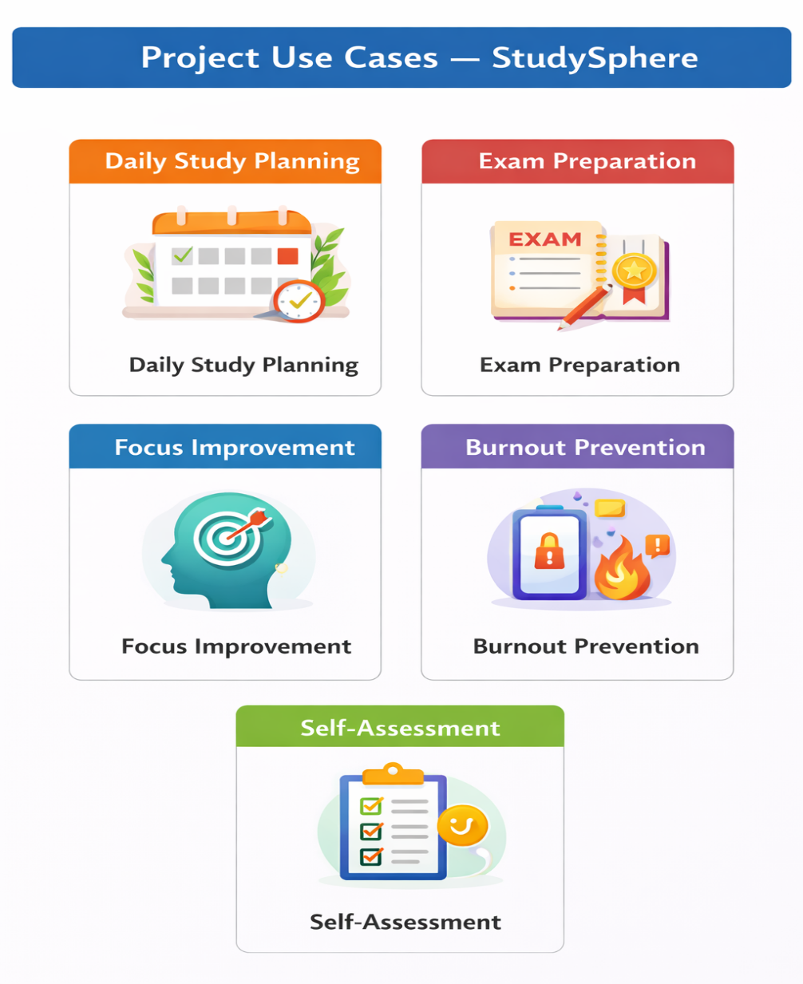
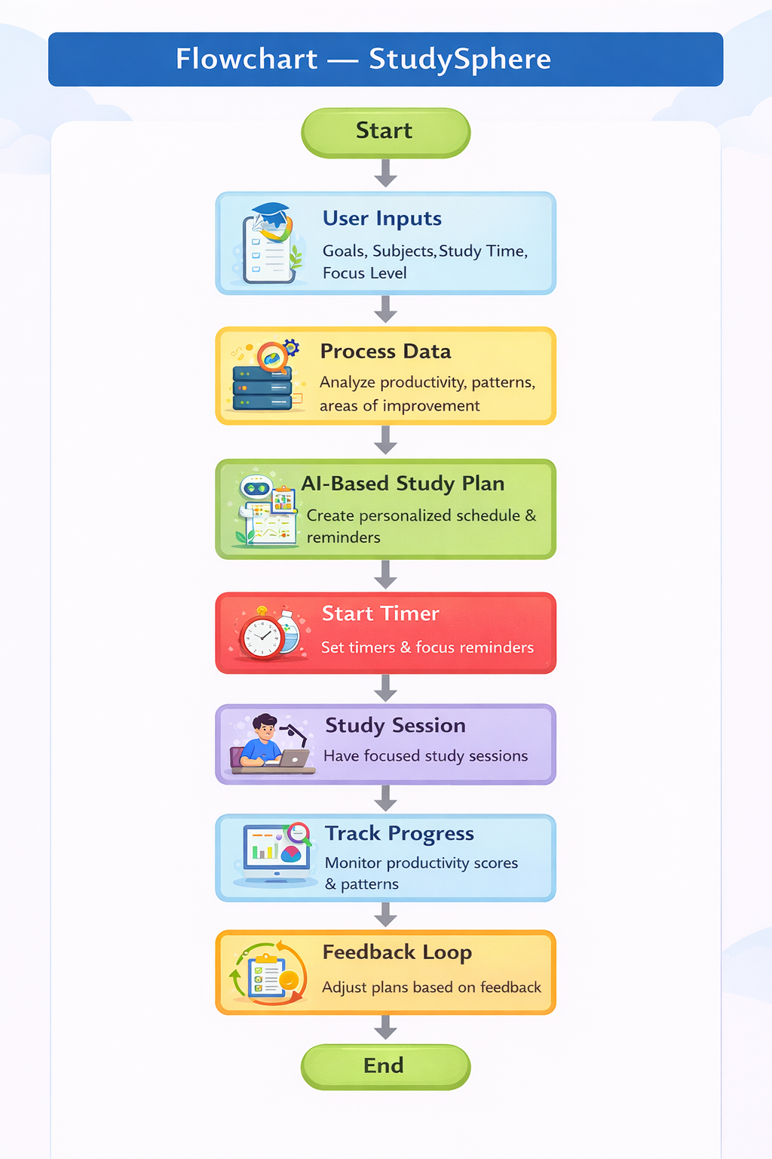
Project Usecases & Scope
Project Use-cases
Project Scope
Notes:
New Courses replaced with New Programmes

Slide 7
Prototype/Project Flow diagram/Architecture
User Login / Sign Up ⬇ User Sets Study Goals & Subjects ⬇ System Analyse Study Time & Focus Inputs ⬇ AI Generates Study Plan & Reminders ⬇ User Studies with Timer & Break Suggestions ⬇ Progress Tracking & Analytics Dashboard ⬇ Feedback & Plan Adjustment
Notes:
New Courses replaced with New Programmes

Slide 8
Data & Resources
Data Sources
User study inputs (subjects, goals, study hours, focus level)
System-generated data (progress, productivity scores, patterns)
Sample academic schedules for testing/demo
Database
MySQL for storing user profiles and study history
Cloud storage for real-time sync and backup
Software & Tools
HTML, CSS, JavaScript / React
Node.js / Python (Flask/Django)
VS Code, GitHub, Google Calendar API, Figma/Canva
Hardware
Laptop/PC, Smartphone (testing), Internet Connection
Notes:
New Courses replaced with New Programmes

Slide 9
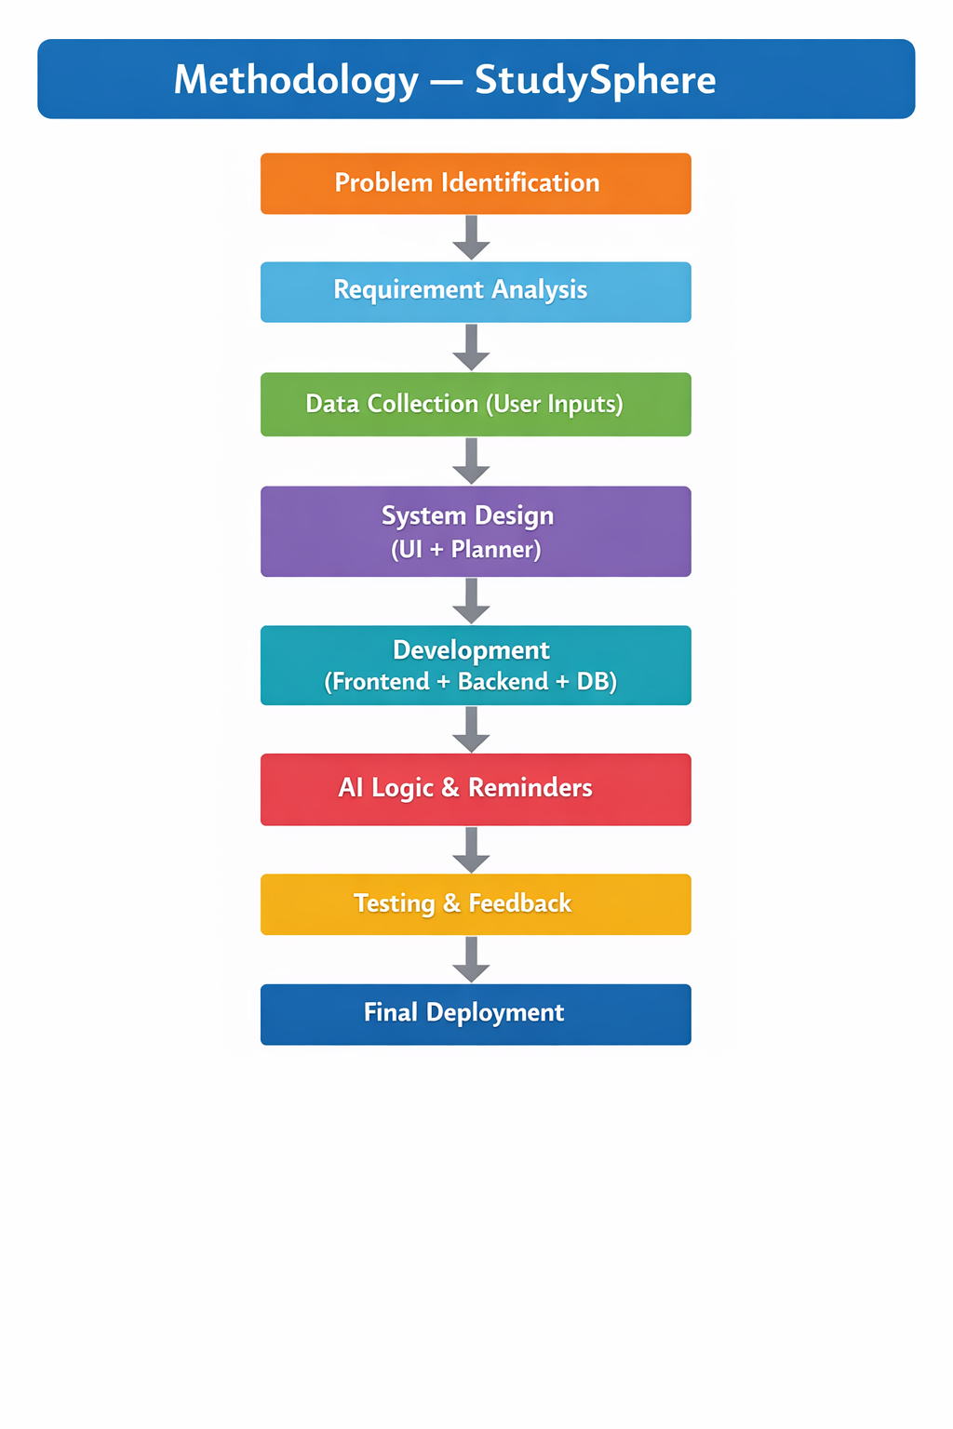
Methodology
Notes:
New Courses replaced with New Programmes

Slide 10
Expected Results & Impact
Expected Results
Students will be able to organize daily study schedules more effectively.
Improved focus and time management through timers and reminders.
Clear visual progress tracking using simple analytics.
Reduction in last-minute exam stress due to planned revisions.
User-friendly interface that is easy for students to adopt.
Impact
Encourages consistent study habits among students.
Helps in balancing academics and personal time.
Demonstrates practical use of AI and productivity tools in education.
Provides a scalable base that can be expanded into a full learning platform in future.
Enhances technical and problem-solving skills of the developer (student)
Notes:
New Courses replaced with New Programmes

Slide 11
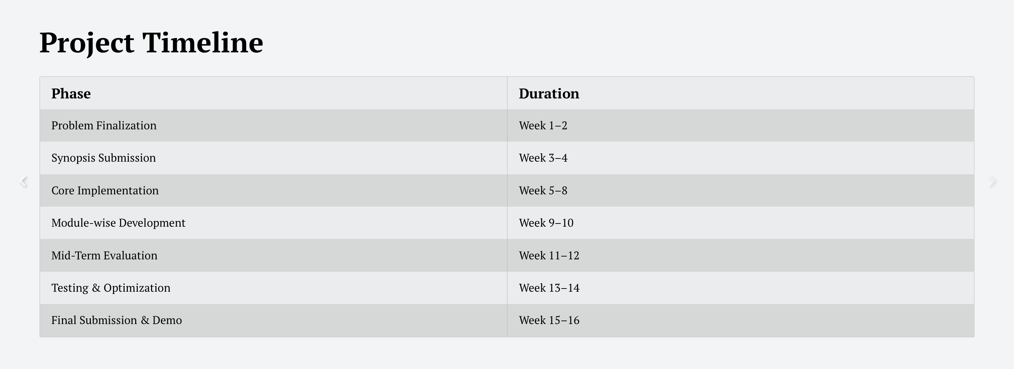
Project Timeline
Notes:
New Courses replaced with New Programmes

Slide 12
THANK YOU

